Slide 1

Cyber terrorism

Slide 2
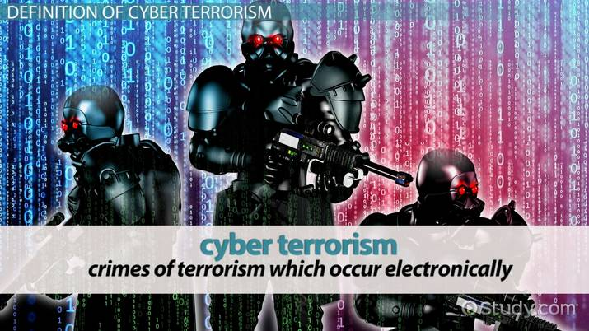
WHAT IS CYBER TERRORISM?
the use of computer network tools to shut down critical national infrastructures.
large-scale disruption of computer networks.

Slide 3

FEAtures of cyber terrorism:
Difficulty identifying attackers
Lack of boundaries
Speed of development
Low cost of tools
Automated methods

Slide 4
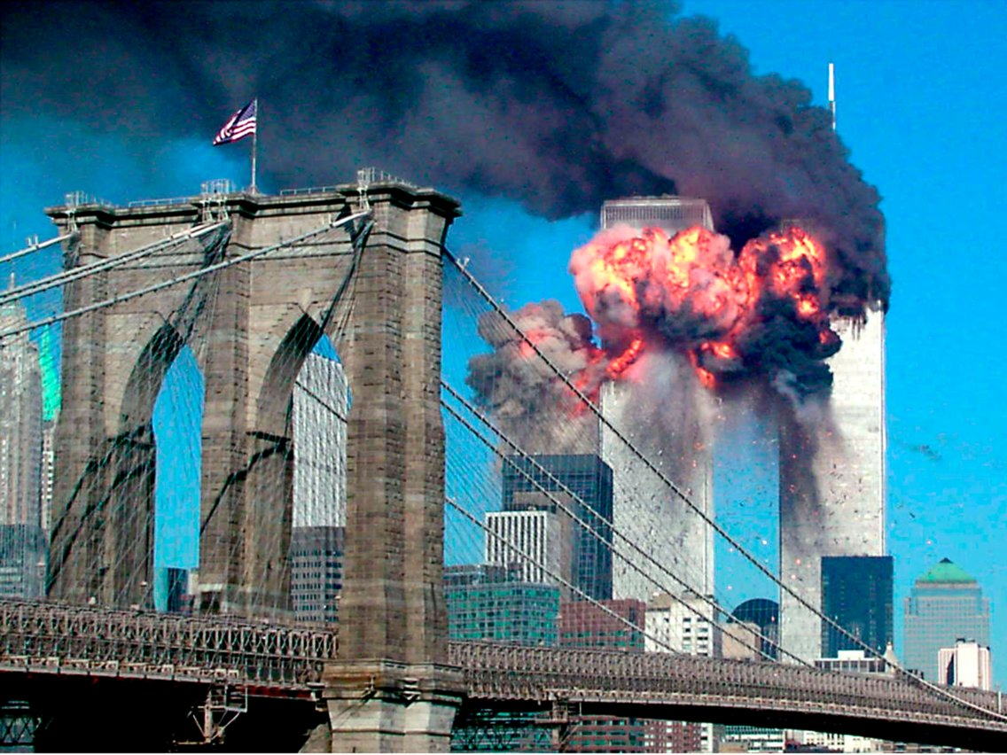
Three most common attack methods:
Ip spoofing
Password cracking
DENIAL-OF-SERVICE ATTACKS

Slide 5
CONCLUSION
ALL WE CAN DO AS CITIZENS IS TO PROTECT OURSELVES BY PROTECTING OUR INFORMATION , WHO WE GIVE IT TO AND HOW MUCH WE GIVE IT OUT.
OUR GOVERNMENT IS TRYING TO DO ITS PART,SO LET US SUPPORT THEM AND THEIR EFFORTS AND STOP THIS CYBER BATTLE.

Slide 6
Presented by:KRITI NIRANJAN, MANSI SHARMA,KANUPRIYA CHAUHAN

